Slide 1
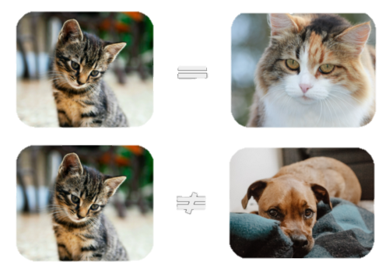
Contrastive Learning
221124 Advanced Computer Vision
Sohee Kim

Slide 2
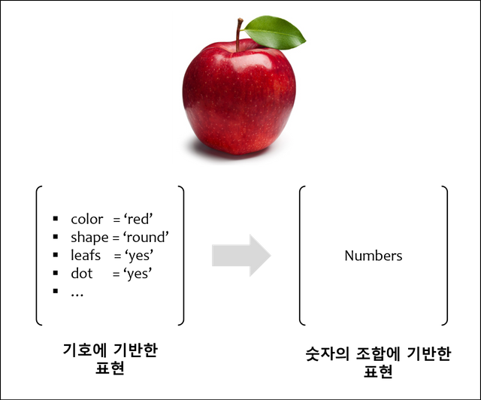
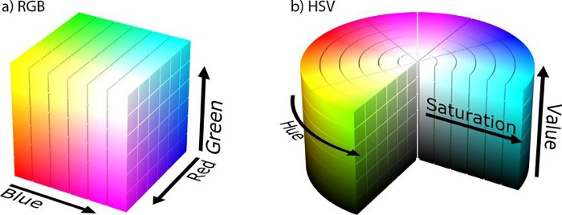
Background
Representation Learning
A class of machine learning approaches that allow a system to discover the representations required for feature detection or classification from raw data
“raw 데이터에서 detection이나 classification에 필요한 표현을 자동으로 검색할 수 있도록 하는 일련의 기술”
Learning useful reprentation based on input data
Representation : Different ways to view data to encode or describe it
Image : RGB format / HSV format
Two approaches
Generative(생성) approaches – generate similar image
Pixel level generation : computationally expensive
Discriminative(판별) approaches – recognize tag, sort data
Train networks to perform pretext tasks : limit the generality of learned representations
https://medium.com/neurosapiens/segmentation-and-classification-with-hsv-8f2406c62b39
https://steemit.com/representation-learning/@hugmanskj/representation-learning
Notes:
Discriminative approaches learn representations using objective functions similar to those used for supervised learning, but train networks to perform pretext tasks where both the inputs and labels are derived from an unlabeled dataset
could limit the generality of the learned representations
기계를 통해 만들어 지고 있는 데이터 들로부터 사물이나 관념에 대한 숫자의 덩어리를 학습하는 것
예) 사과라는 사물을 기술하게 되면, 특성들을 자세하게 적는 방식으로 데이터 구축.
-> 딥러닝 : 사과를 사과라고 할 수 있는 표현을 숫자형태로 기술하도록 학습
표현 학습 – 두가지 접근법 존재. 생성모델 측면, 판별모델 측면
생성 모델의 예는 유사한 이미지를 생성하기 위해 실제 세계의 이미지 컬렉션에 대해 훈련된 모델
생성 모델링은 기존 데이터를 식별하고 데이터를 분류하는 데 사용할 수 있는 판별 모델링과 대조됩니다. 생성 모델링은 무언가를 생성합니다. 판별 모델링은 태그를 인식하고 데이터를 정렬합니다.
위의 예에서 생성 모델은 설명 모델에 의해 향상될 수 있으며 그 반대도 마찬가지입니다. 이는 생성 모델이 생성된 이미지가 실제라고 믿도록 판별 모델을 속이도록 함으로써 수행됩니다. 일련의 훈련을 통해 둘 다 자신의 작업에서 더욱 정교해집니다.

Slide 3
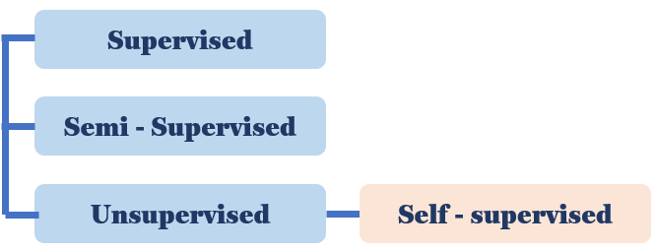
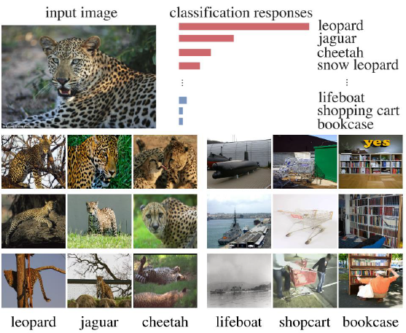
Background
Self-supervised Learning
Deep learning – need enough quality and data
Labeling process is essential → Difficult to collect sufficiently
A field of Unsupervised – learns features from unlabeled input data train
A method designed to obtain its own label using information that can be obtained from data
Motivation of Contrastive Learning
Input image : cheetah ⇒ Classification response : Classification rates of leopards, jaguars, etc. are higher than those of boats or shopping carts
It can be seen that similar features are acting on cheetahs, raopards, jaguars, etc., and these well-extracted feature values start with the assumption that they will have similarity information between instances
> Result of image classification model based on supervised
https://daeun-computer-uneasy.tistory.com/37
Notes:
래오파드, 재규어 등의 분류 비율이 보트나 쇼핑 카트의 분류 비율보다 높음
치타, 래오파드, 재규어 등에 유사한 feature가 작용하고 있음을 확인할 수 있으며, 이렇게 잘 추출된 특징 값은 instance간의 유사도 정보를 가지고 있을 것이라는 가정으로 시작

Slide 4
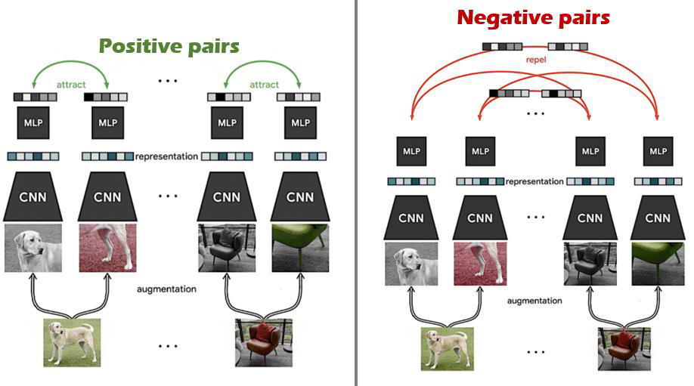
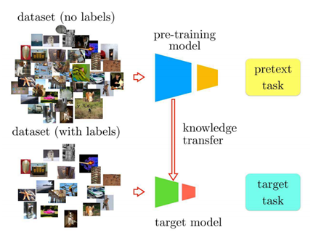
Background
Contrastive Learning
One way to perform Representation learning
An approach to use Self-supervised learning
Learning through comparison between the input samples
Composed of Positive pair and Negative pair
Positive pair – close, Negative pair – far apart
To learn such an embedding space in which Similar samples stay close together, while dissimilar ones are far apart
Advantages: data construction costs are none and learn easier
Use Unlabelled data ⇒ representation is more general, can respond to new classes
It is used as a way to fine-tuning network for various Downstream tasks(classification)
It is much simpler to perform fine-tuning with other tasks in that it can be done without modification of the model structure
> Train with using Pretext task
https://daebaq27.tistory.com/97
https://velog.io/@jhlee508/논문-정리-A-Simple-Framework-for-Contrastive-Learning-of-Visual-Representations
Notes:
Contrastive Learning을 간단히 설명하자면, 같은 이미지에 augmentation을 가한 뒤, 기준인 anchor와 positive 사이의 positive pair의 embedded vector가 유사해지도록 학습을 하고, 다른 이미지에 서로 다른 augmentation을 가한 뒤, 기준인 anchor embedded vector와 negative embedded vector 사이의 거리는 멀어지도록 학습을 시키는 것이다.
위에 기반하여 Contrastive Learning은 representation 학습에 있어서 간단하면서도 효과적이라는 장점이 있다.
The goal of contrastive representation learning is to learn such an embedding space in which similar sample pairs stay close to each other while dissimilar ones are far apart

Slide 5
A Simple Framework for Contrastive Learning of Visual Representations
Chen, Ting, et al. (Google Research)
International conference on machine learning. PMLR, 2020.
Notes:
Google Research
https://teang1995.tistory.com/10

Slide 6
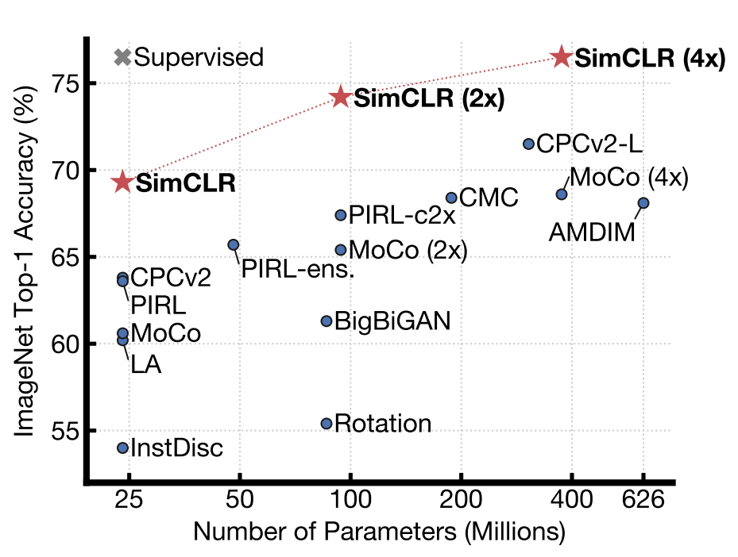
1. Introduction
Chen, Ting, et al. "A simple framework for contrastive learning of visual representations." International conference on machine learning. PMLR, 2020.
SimCLR - a simple framework for contrastive learning of visual representations
Outperforms previous work
Simpler, requiring neither specialized architectures nor a memory bank
Major components
Composition of multiple data augmentation operations is crucial in defining the contrastive prediction tasks
Introducing a learnable nonlinear transformation between the representation and the contrastive loss substantially improves the quality of the learned representations
Benefits from larger batch sizes and longer training compared to its supervised counterpart
ImageNet Top-1 accuracy of linear classifiers trained on representations learned with different self-supervised methods (pretrained on ImageNet). Gray cross indicates supervised ResNet-50. Our method, SimCLR, is shown in bold.
Notes:
1.간단한 몇 개의 data augmentation composition(조합)이 SimCLR 구조에서 중요한 역할을 한다.
2.Representation과 Contrastive loss 사이의 non-linear transformation이 representation 성능을 향상시킨다.
3.더 큰 batch size와 longer training step에 의해 supervised learning 보다 더 큰 성능 향상을 보인다.

Slide 7
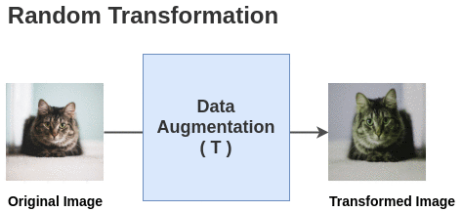
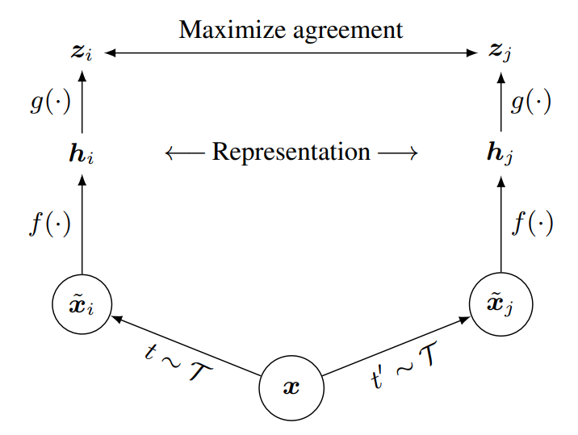
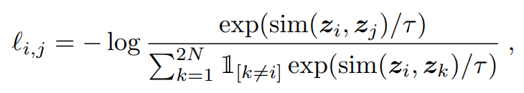
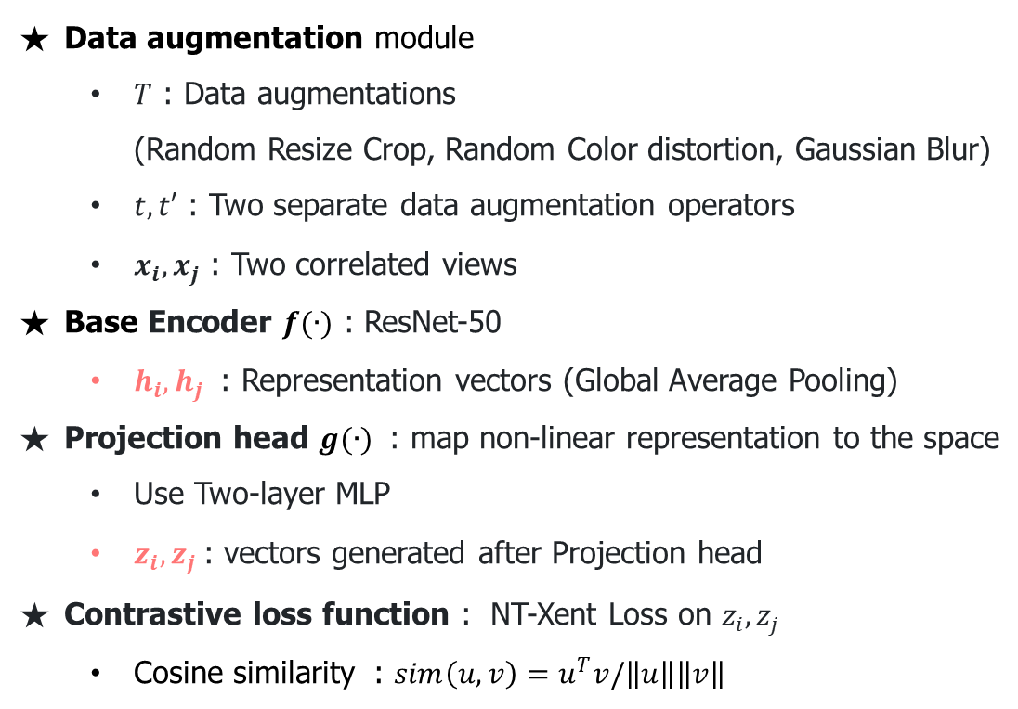
2. Method
Chen, Ting, et al. "A simple framework for contrastive learning of visual representations." International conference on machine learning. PMLR, 2020.
The Contrastive Learning Framework
Data augmentation module
$T$ : Data augmentations (Random Resize Crop, Random Color distortion, Gaussian Blur)
$t, t′$ : Two separate data augmentation operators
$x_{i}, x_{j}$​ : Two correlated views
Base Encoder $f(∙)$ : ResNet-50
$h_{i}, h_{j}$​ : Representation vectors (Global Average Pooling)
Projection head $g(∙)$ : map non-linear representation to the space
Use Two-layer MLP
$z_{i}, z_{j}$: vectors generated after Projection head
Contrastive loss function : NT-Xent Loss on $z_{i}, z_{j}$
Cosine similarity : $sim\left(u,v\right)=u^{T}v/\left\|u\right\|\left\|v\right\|$
MLP
Encoding
(ResNet50)
Data augmentation
No explicit negative sampling
Minibatch(N) → 2N data points
Negative sample : 2(N-1) data points Positive sample : 1 data point
Same image → hight similarity
Different image → low similarity
Notes:
this framework comprises these four major components.
1. Randomly sample a minibatch of N samples and each sample is applied with two different data augmentation operations, resulting in 2N augmented samples in total.
Two separate data augmentation operators are sampled from the same family of augmentations (t ∼ T and t 0 ∼ T ) and applied to each data example to obtain two correlated views, xi and xj.
Here, Data augmentation includes random crop, resize with random flip, color distortions, and Gaussian blur.
2. Given one positive pair, other 2(N-1) data points are treated as negative samples
A neural network base encoder f(·) extracts representation vectors h from augmented data examples
3. The contrastive learning loss is defined using cosine similarity. sim(.,.).
A small neural network projection head g(·) that maps representations to the space where contrastive loss is applied.
A base encoder network f(·) and a projection head g(·) are trained to maximize agreement using a contrastive loss.
The contrastive learning loss is defined using cosine similarity sim(.,.).
Note that the loss operates on an extra projection layer of the representation g(.) rather than on the representation space directly.
But After training is completed, for downstream tasks, the projection head g(·) is throwed away, and encoder f(·) and representation h are used.
NT-Xent loss : the normalized temperature-scaled cross entropy loss
위의 식에서 로그 안의 항을 분리해주면 , 분모의 식은 positive sample 간의 유사도, 분모의 식은 나머지 negative sample 과의 유사도의 합를 의미
즉 loss function은 , positive sample 간의 유사도는 크게, negative sample 간의 유사도는 작게 해주는 효과

Slide 8
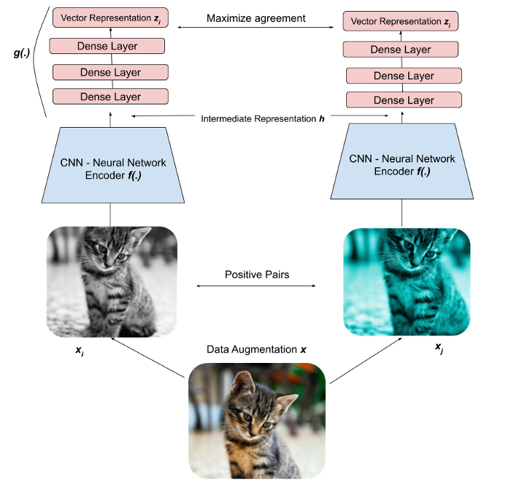
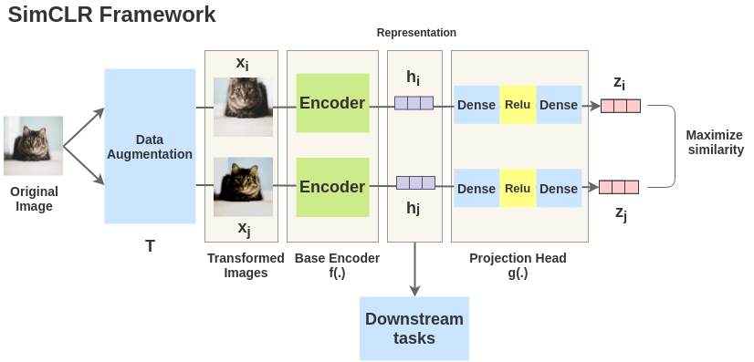
2. Method
Chen, Ting, et al. "A simple framework for contrastive learning of visual representations." International conference on machine learning. PMLR, 2020.
The Contrastive Learning Framework overview
https://amitness.com/2020/03/illustrated-simclr/
https://towardsdatascience.com/understanding-contrastive-learning-d5b19fd96607
Notes:
The idea of SimCLR framework is very simple. An image is taken and random transformations are applied to it to get a pair of two augmented images xixi and xjxj. Each image in that pair is passed through an encoder to get representations. Then a non-linear fully connected layer is applied to get representations z. The task is to maximize the similarity between these two representations zizi and zjzj for the same image.
우선, 이미지에 augentation을 적용하여 2개의 dataset ~xixi~ 와 ~xjxj~ 를 생성한다. 여기서 이 두 개의 dataset은 positive pair이라고 부른다. 본 논문에서는 3개의 augmentation을 순차적으로 적용했는데 random cropping, random color distortion, random Guassian blur 이다.
이렇게 생성된 2개의 이미지는 base encoder f 를 통해 각 이미지의 representation vector를 뽑아낸다. 여기서 base encoder로 다양한 CNN model을 사용할 수 있지만 본 논문에서는 ResNet을 적용하였다. 이를 수식으로 표현하면 hi = f(xi) = ResNet(xi) 가 되며 여기서 hi 는 average pooling layer를 거친 output layer의 값이다.
hi와 hj가 생성된 후에는 Projection head gg 를 거친다. gg 는 contrastive loss의 latent space로 변형해주는 역할을 한다. 여기서는 1개의 hidden layer를 갖고 있는 MLP를 사용했으며 중간에 Relu non-linearity function을 적용해주었다.

Slide 9
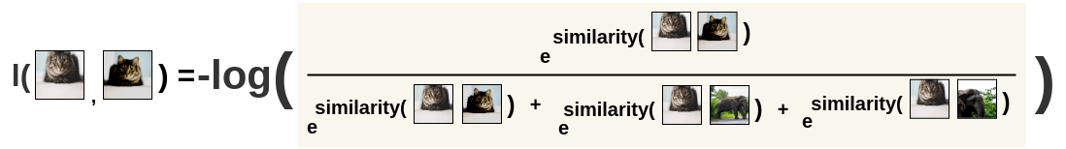
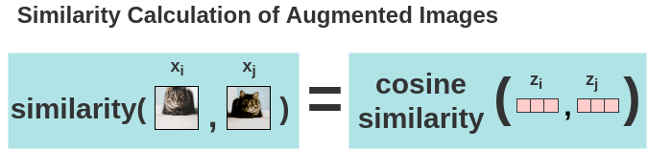
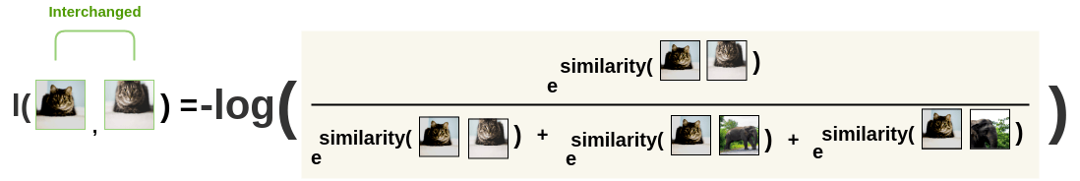
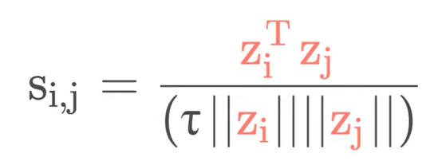
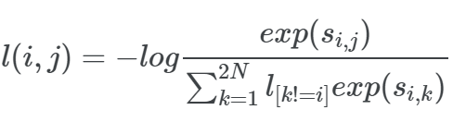
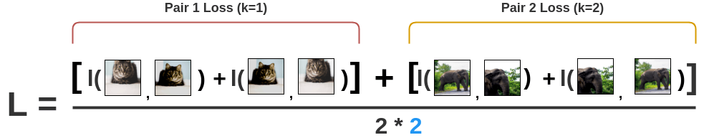
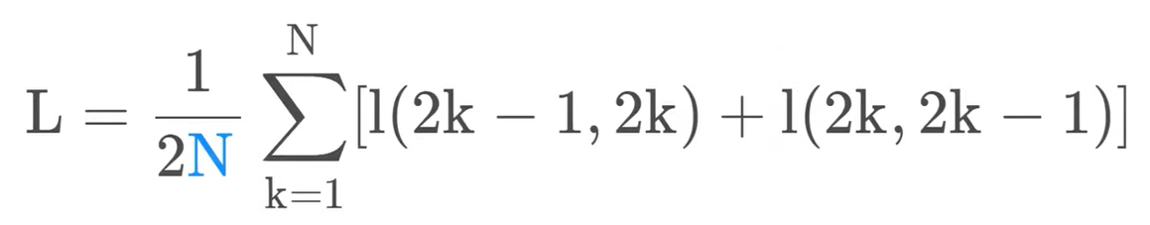
2. Method
Chen, Ting, et al. "A simple framework for contrastive learning of visual representations." International conference on machine learning. PMLR, 2020.
Tuning Model: Bringing similar closer
2. NT-Xent Loss calculation
1. Calculation of cosine similarity
Cosine similarity
NT-Xent Loss : -log(softmax)
Compute loss over all the pairs in the batch size (N=2) and take an average
https://amitness.com/2020/03/illustrated-simclr/
Notes:
Now, the similarity between two augmented versions of an image is calculated using cosine similarity. For two augmented images xixi and xjxj, the cosine similarity is calculated on its projected representations zizi and zjzj.
Nest, SimCLR uses a contrastive loss called “NT-Xent loss” (Normalized Temperature-Scaled Cross-Entropy Loss)
The augmented pairs in the batch are taken one by one, and the softmax function is applied to get the probability of these two images being similar. Then the loss is calculated for a pair by taking the negative of the log like this. For interchanged images, they calculate the loss for the same pair a second time.
Finally, they compute loss over all the pairs in the batch of size 2 and take an average.
Based on the loss, the encoder and projection head representations improves over time and the representations obtained place similar images closer in the space.
NT-Xent loss : the normalized temperature-scaled cross entropy loss
=> 전체 batch size에 대한 모든 pair의 loss를 구하여 다 더하고 평균을 낸다.

Slide 10
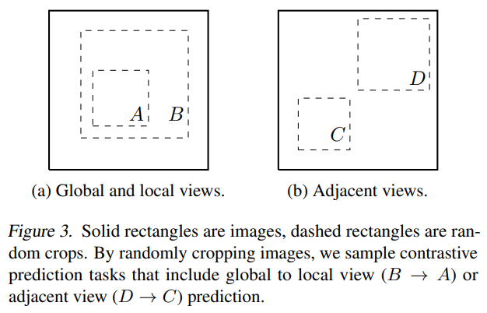
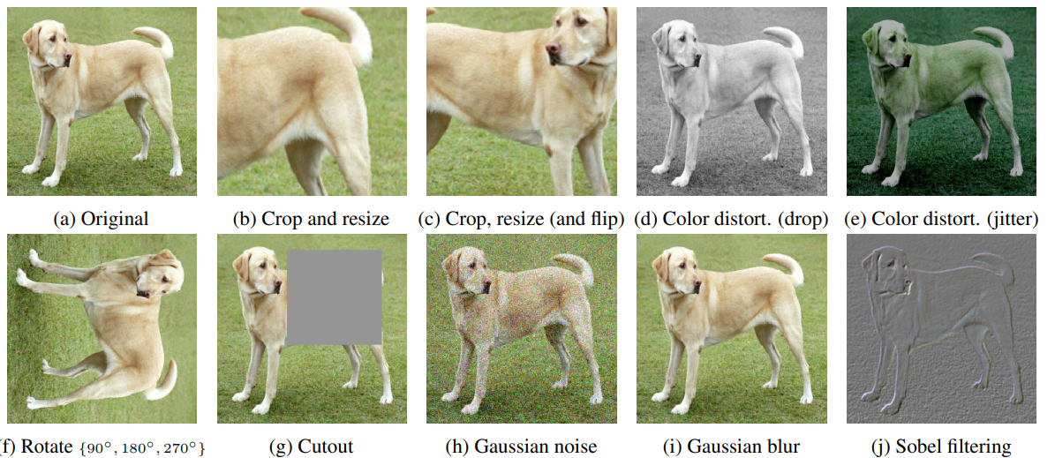
3. Data Augmentation for Contrastive Representation Learning
Chen, Ting, et al. "A simple framework for contrastive learning of visual representations." International conference on machine learning. PMLR, 2020.
Data Augmentation
Augmentations
Many existing approaches : change the architecture to define contrastive prediction tasks
Perform simple random cropping of target images – contain all of things abocve
Spatial/geometric transformation
Cropping, resizing, rotating, cutout
Appearance transformation
Color distortion, Gaussian blur, Sobel filtering
Decouple(분리) Predictive task with NN architecture
Notes:
We show that complexity can be avoided by performing simple random cropping (with resizing) of target images, which creates a family of predictive tasks subsuming the above mentioned two, as shown in Figure 3.
This simple design choice conveniently decouples the predictive task from other components such as the neural network architecture.
One type of augmentation involves spatial/geometric transformation of data, such as cropping, resizing, rotating, cutout.
The other type of augmentation involves appearance transformation, such as color distortion, gausian blur, sobel filtering.
In this paper, they used only the ones in red.

Slide 11
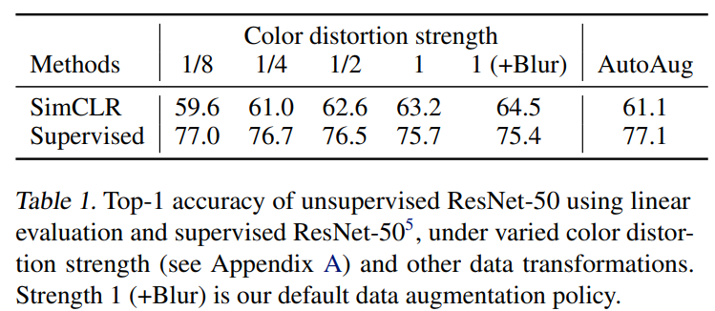
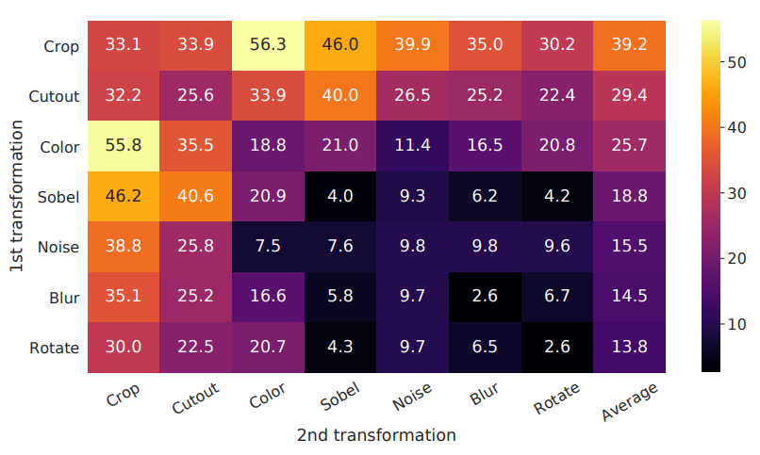
3. Data Augmentation for Contrastive Representation Learning
Chen, Ting, et al. "A simple framework for contrastive learning of visual representations." International conference on machine learning. PMLR, 2020.
Linear evaluation results under individual and composition of transformations
Color Augmentation strength
Stronger color augmentation → improves
Simple cropping + stronger color distortion > Auto Augment(supervised)
Unsupervised contrastive learning benefits from stronger (color) data augmentation than supervised learning
No single transformation suffices to learn good representations
When composing augmentations, the contrastive prediction task becomes harder, but the quality of representation improves
Best : Random Crop + Random Color Distortion
Notes:
To understand the effects of individual data augmentations and the importance of augmentation composition, we investigate the performance of our framework when applying augmentations individually or in pairs
Branch 한쪽은 crop만, 다른 한쪽은 augmentation 방법 사용해서 각 방법의 성능 실험함
To further demonstrate the importance of the color augmentation, they adjust the strength of color augmentation.
Stronger color augmentation substantially improves the linear evaluation of the learned unsupervised models.
And simple cropping + stronger color distortion was better than auto augment which use supervised learning.
So It means that unsupervised contrastive learning benefits from stronger (color) data augmentation than supervised learning

Slide 12
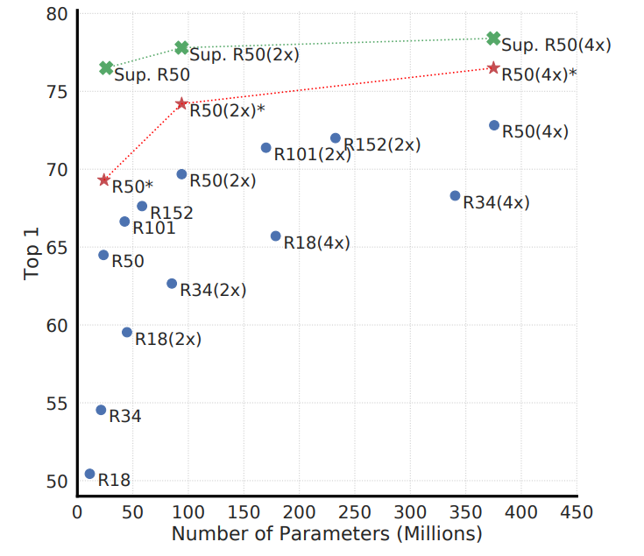
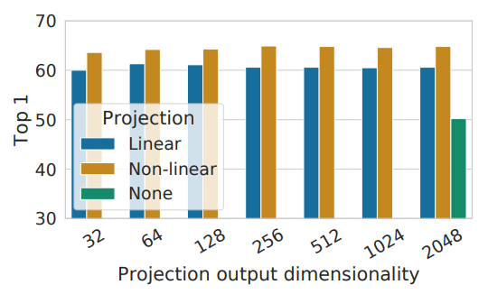
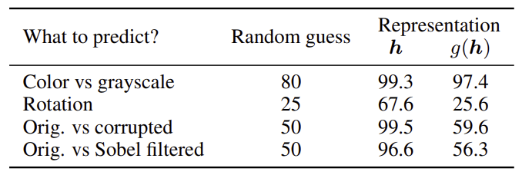
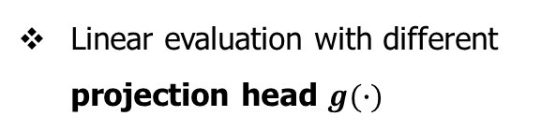
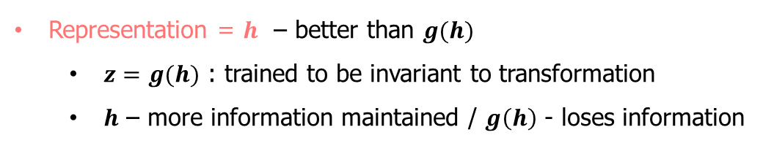
4. Architectures for Encoder and Head
Chen, Ting, et al. "A simple framework for contrastive learning of visual representations." International conference on machine learning. PMLR, 2020.
Projection heads
Linear evaluation of supervised / unsupervised
Linear evaluation with different projection head $g(∙)$
- Projection :
Nonlinear > Linear > None
Accuracy of training additional MLPs
Representation = $h$ – better than $g(h)$
$z=g(h)$ : trained to be invariant to transformation
$h$ – more information maintained / $g\left(h\right)$ - loses information
Unsupervised contrastive learning benefits (more) from bigger models
12/15
Notes:
Models in blue dots are ours trained for 100 epochs, models in red stars are ours trained for 1000 epochs, and models in green crosses are supervised ResNets trained for 90 epochs
Figure 7 shows that increasing depth and width both improve performance
unsupervised learning benefits more from bigger models than its supervised counterpart.
We then study the importance of including a projection head, g(h).
First graph shows linear evaluation of representations with different projection heads. The nonlinear projection is better than a linear, and much better than a no projection.
Furthermore, even the nonlinear projection is used, the hidden layer before the projection head (h) is a better representation than the layer after. (z)
This is because z is trained to be invariant to data transformation. Thus, by leveraging the nonlinear projection, more information can be formed and maintained in h. The table shows that h contains more information when g(h) loses information.
ResNet-50 in 3 different hidden layer widths (width multipliers of 1×, 2×, and 4×).

Slide 13
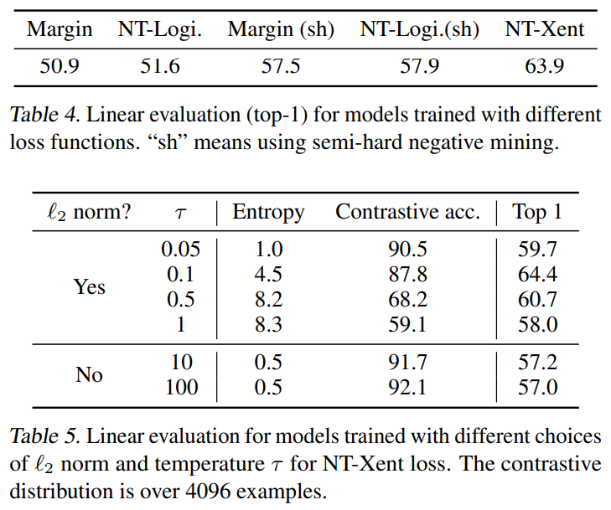
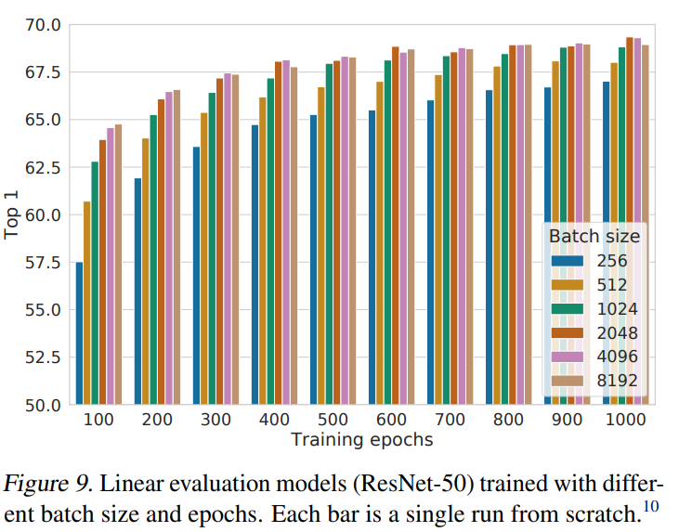
5. Loss Functions and Batch Size
Chen, Ting, et al. "A simple framework for contrastive learning of visual representations." International conference on machine learning. PMLR, 2020.
Loss function
Batch size
NT-Xent performed best
Larger Batch Size → better
Larger batch sizes provide more negative examples, facilitating convergence
Notes:
They compare the NT-Xent loss against other commonly used contrastive loss functions.
As a result, NT-Xent showed the best result
Table 5 shows that without normalization and proper temperature scaling, performance is significantly worse. Without l2 normalization, the contrastive task accuracy is higher, but the resulting representation is worse under linear evaluation.
Figure 9 shows the impact of batch size when models are trained for different numbers of epochs.
When the number of training epochs is small (like 100), Larger batch size have a significant advantage over the smaller ones.
Because in contrastive learning, larger batch sizes provide more negative examples, facilitating convergence

Slide 14
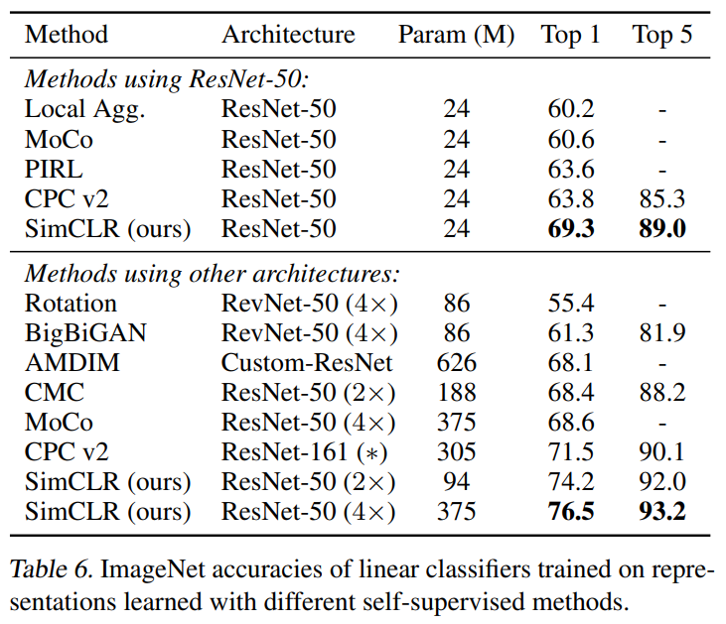
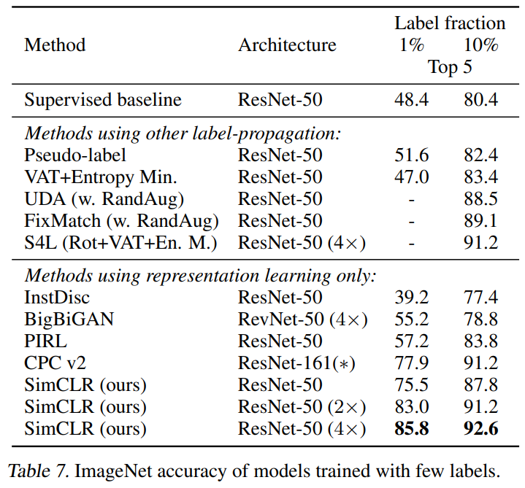
6. Comparison with State-of-the-art
Chen, Ting, et al. "A simple framework for contrastive learning of visual representations." International conference on machine learning. PMLR, 2020.
Linear evaluation
Semi-supervised learning
Compare with previous approaches (Self-supervised model)
SimCLR : best performance
Sample 1% or 10% of the labeled ILSVRC-12 training datasets in a class-balanced way, fine-tune the whole base network on the labeled data
14/15
Notes:
Table 7 shows the comparisons of our results against recent methods
Again, our approach significantly improves over state-of-the-art with both 1% and 10% of the labels

Slide 15
7. Conclusion
Chen, Ting, et al. "A simple framework for contrastive learning of visual representations." International conference on machine learning. PMLR, 2020.
SimCLR
Self-supervised Learning Simple framework
Improve performance of Self-supervised learning, Semi-supervised learning, Transfer learning
Difference from standard Supervised learning
Data augmentation, non-linear projection head, the loss function
By training to learn Representation, performance achieved at the level of Supervised learning
The strength of this simple framework suggests that, despite a recent surge in interest, self-supervised learning remains undervalued
Notes:
In this work, they present a simple framework and its instantiation for contrastive visual representation learning.
By combining their findings, they improve considerably over previous methods for selfsupervised, semi-supervised, and transfer learning.
This approach differs from standard supervised learning on ImageNet only in the choice of data augmentation, the use of a nonlinear head at the end of the network, and the loss function.
The strength of this simple framework suggests that, despite a recent surge in interest, self-supervised learning remains undervalued.

